Slide 1
Digital Portfolio
STUDENT NAME: P.SANDEEP
REGISTER NO AND NMID: 222407656 AND asunm1453222407656
DEPARTMENT: BSC
COLLEGE: VELTECH RANGA SANKU ARTS COLLEGE / MADRAS UNIVERSITY

Slide 2
PROJECT TITLE
_{DIGITAL PORTFOLIO}

Slide 3


AGENDA
Problem Statement
Project Overview
End Users
Tools and Technologies
Portfolio design and Layout
Features and Functionality
Results and Screenshots
Conclusion
Github Link
3/21/2024 Annual Review

Slide 4

PROBLEM STATEMENT
Many students and professionals struggle to create a comprehensive and visually appealing digital portfolio that effectively showcases their skills and projects to potential employers."

Slide 5

PROJECT OVERVIEW
"This project is a web-based digital portfolio designed to provide a user-friendly platform for individuals to build, customize, and share their professional achievements. It includes features for organizing projects, adding detailed descriptions, and linking to live examples."

Slide 6

WHO ARE THE END USERS?
The primary end users are students, recent graduates, freelancers, and professionals in fields such as design, development, and marketing who need a digital presence to highlight their work."

Slide 7

TOOLS AND TECHNIQUES
Front-end: HTML, CSS, JavaScript (React.js). Back-end: Node.js, Express.js. Database: MongoDB. Other tools: Git, GitHub, VS Code, Figma for UI/UX design."

Slide 8
POTFOLIO DESIGN AND LAYOUT
The design is clean, modern, and minimalist, with a focus on user experience (UX). The layout is intuitive, featuring a clear navigation menu, a prominent 'About Me' section, and a dedicated 'Projects' gallery with individual project pages."
8

Slide 9
FEATURES AND FUNCTIONALITY
​Customizable Sections: Users can add, remove, and reorder sections (e.g., About, Projects, Experience, Skills).
​Project Showcase: Allows for adding multiple projects with images, videos, descriptions, and links.
​Responsive Design: The portfolio adapts to different screen sizes (desktop, tablet, mobile).
​Contact Form: A built-in form for visitors to get in touch.
​Downloadable Resume: Option to link or directly download a PDF version of the user's resume."

Slide 10
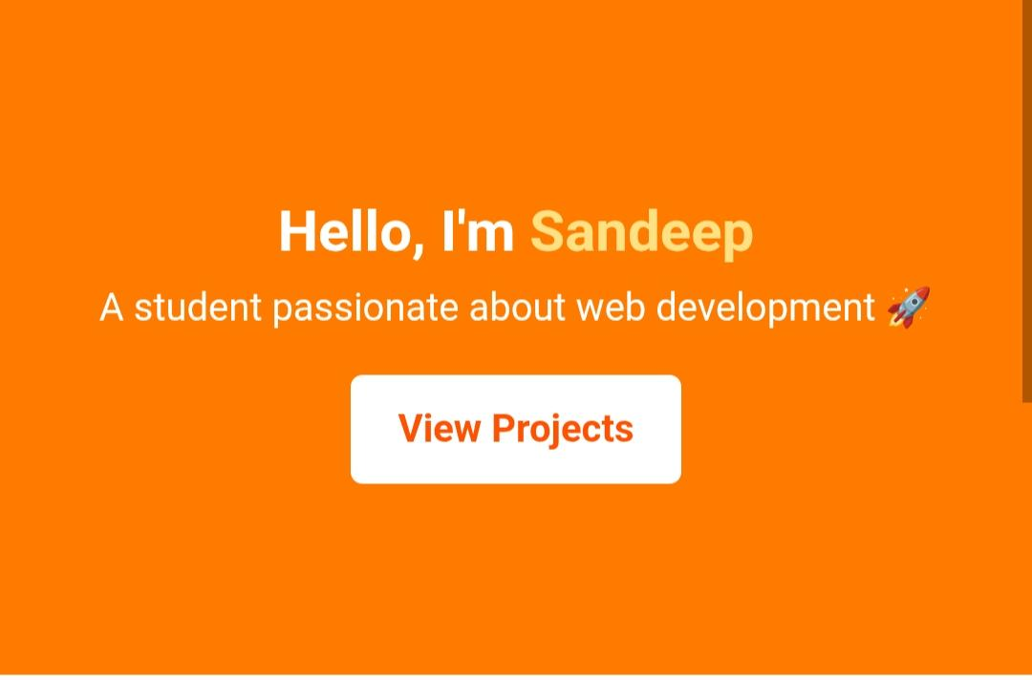
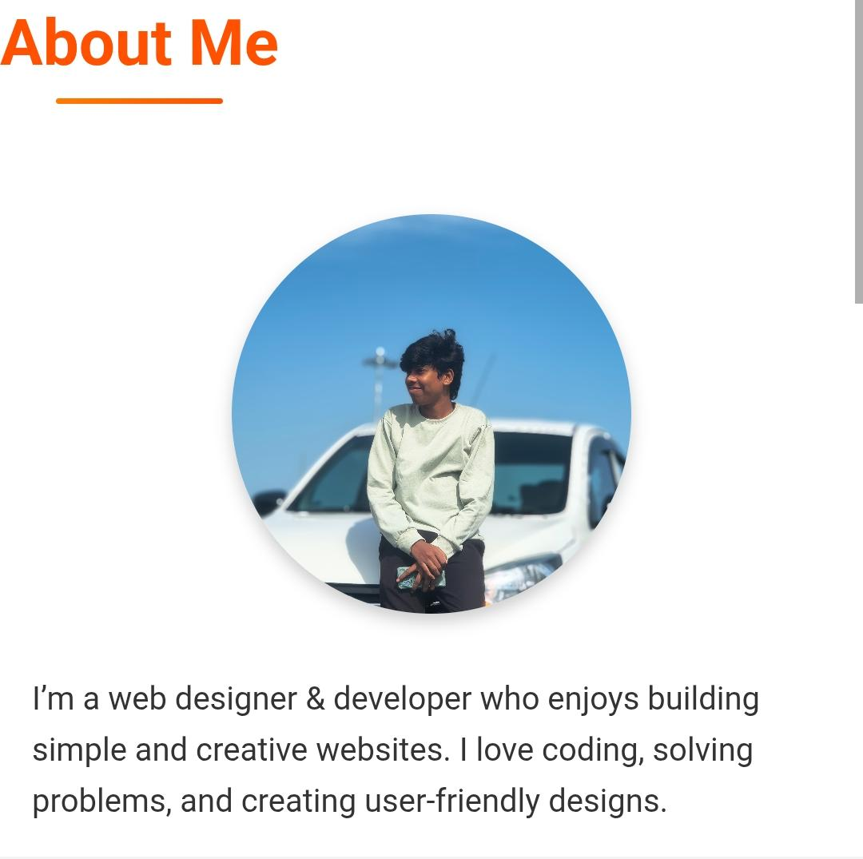
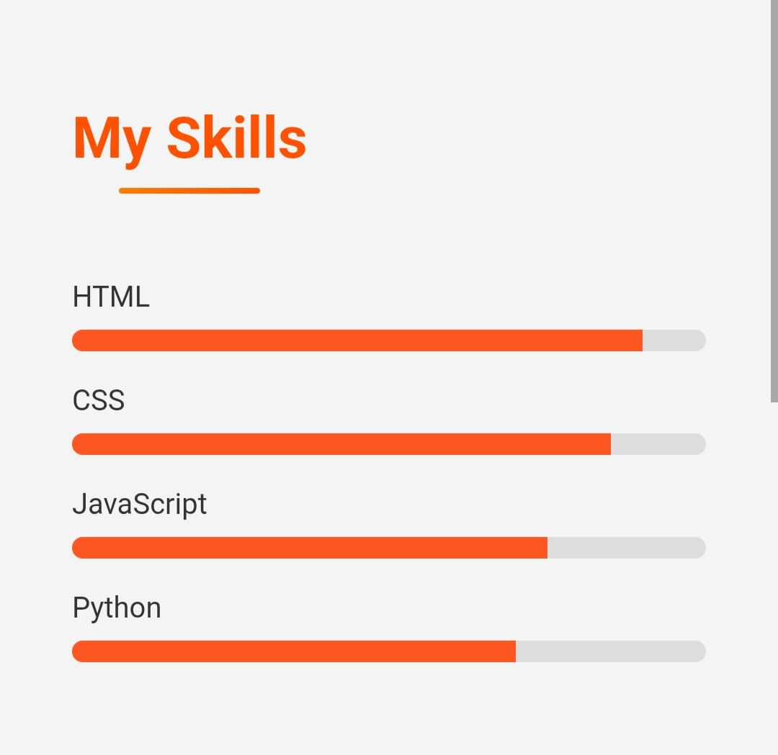
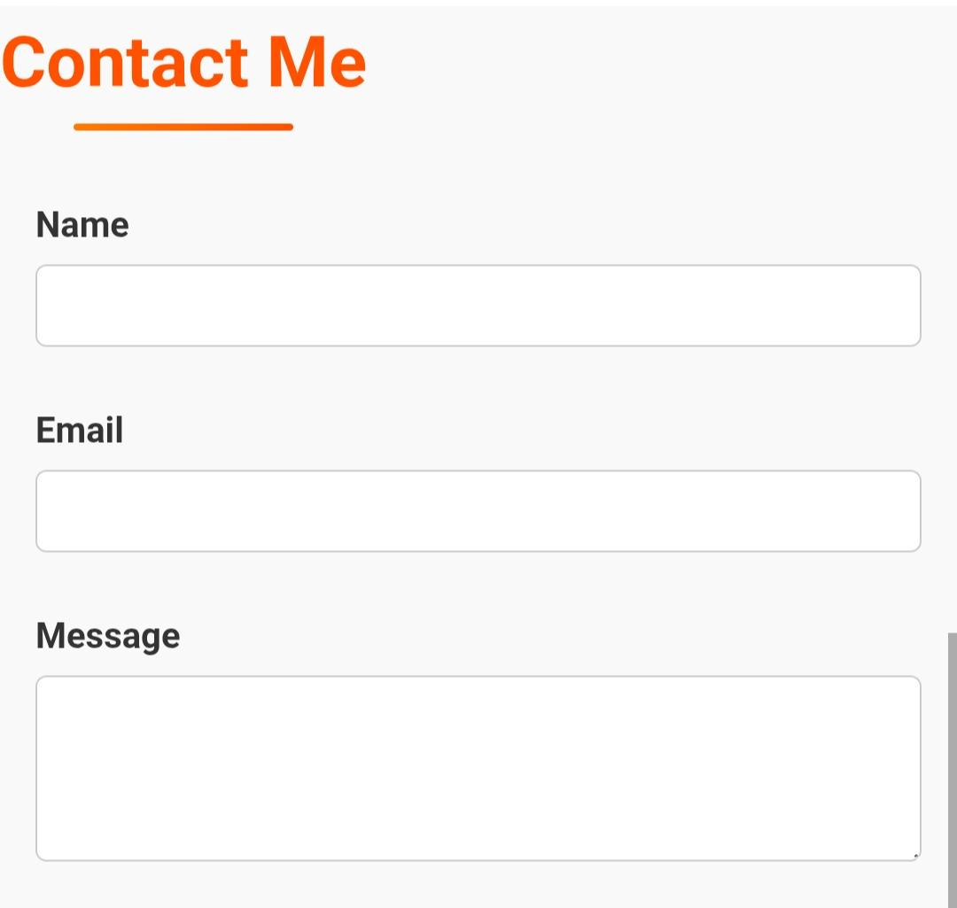

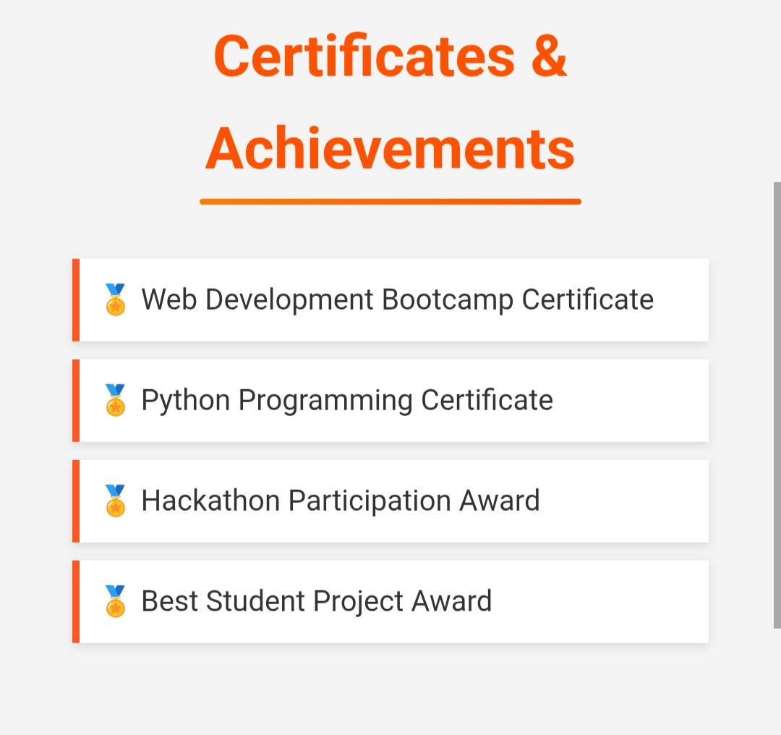
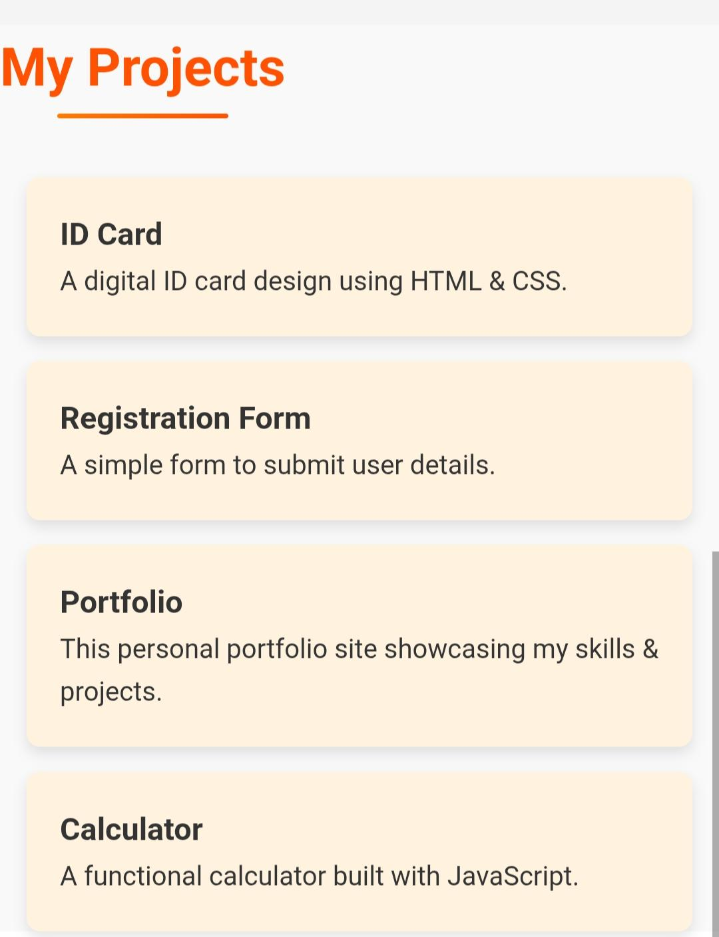
RESULTS AND SCREENSHOTS
Include screenshots of different pages of your portfolio, such as the homepage, a project details page, and the contact page. You can also show mockups of the mobile view.
3/21/2024 Annual Review
10

Slide 11
CONCLUSION
"This digital portfolio project successfully created a robust and elegant solution for individuals to present their professional identity online. It serves as a valuable tool for career development and networking."
11

